Slide 1
Chapter 3 - Processes
1
Notes:
26.12.13
1

Slide 2
Introduction
Communication takes place between processes
A process is a program in execution
from OS perspective, management and scheduling of processes is important
Other important issues arise in distributed systems
multithreading to enhance performance
how are clients and servers organized
process or code migration to achieve scalability and to dynamically configure clients and servers
2

Slide 3
Threads take turns in running
Threads allow multiple executions to take place in the same process environment, called multithreading
Thread Usage – Why do we need threads?
e.g., a wordprocessor has different parts; parts for
interacting with the user
formatting the page as soon as changes are made
timed savings (for auto recovery)
spelling and grammar checking, etc.
1. Simplifying the programming model: since many activities are going on at once
2. They are easier to create and destroy than processes since they do not have any resources attached to them
3. Performance improves by overlapping activities if there is too much I/O; i.e., to avoid blocking when waiting for input or doing calculations, say in a spreadsheet
4. Real parallelism is possible in a multiprocessor system
3

Slide 4
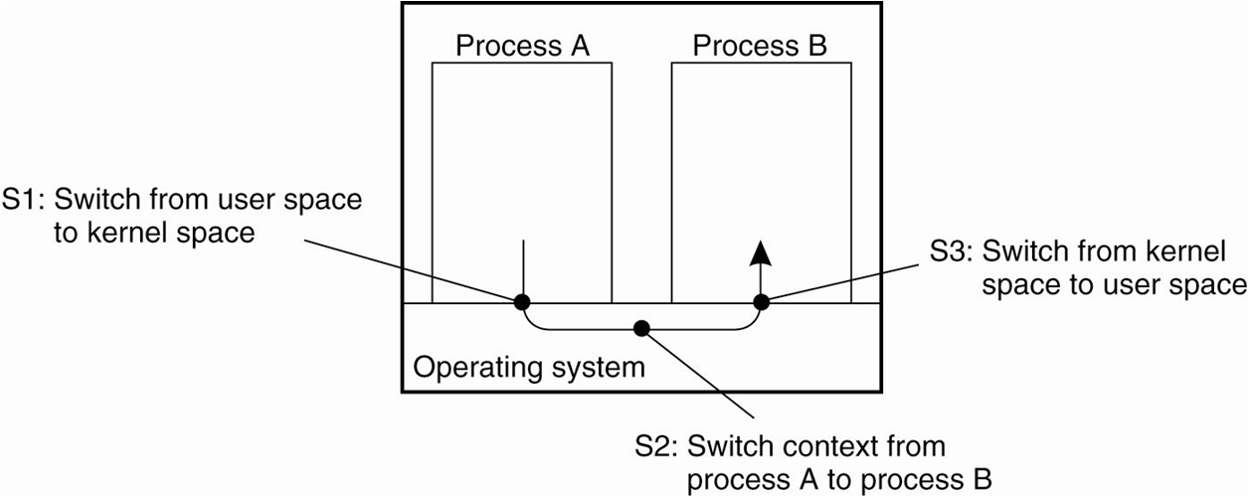
having finer granularity in terms of multiple threads per process rather than processes provides better performance and makes it easier to build distributed applications
in nondistributed systems, threads can be used with shared data instead of processes to avoid context switching overhead in interprocess communication (IPC)
context switching as the result of IPC
4

Slide 5
Thread Implementation
threads are usually provided in the form of a thread package
the package contains operations to create and destroy a thread, operations on synchronization variables such as mutexes and condition variables
two approaches of constructing a thread package
construct a thread library that is executed entirely in user mode (the OS is not aware of threads)
cheap to create and destroy threads; just allocate and free memory
context switching can be done using few instructions; store and reload only CPU register values
disadv: invocation of a blocking system call will block the entire process to which the thread belongs and all other threads in that process
implement them in the OS’s kernel
let the kernel be aware of threads and schedule them
expensive for thread operations such as creation and deletion since each requires a system call
5

Slide 6
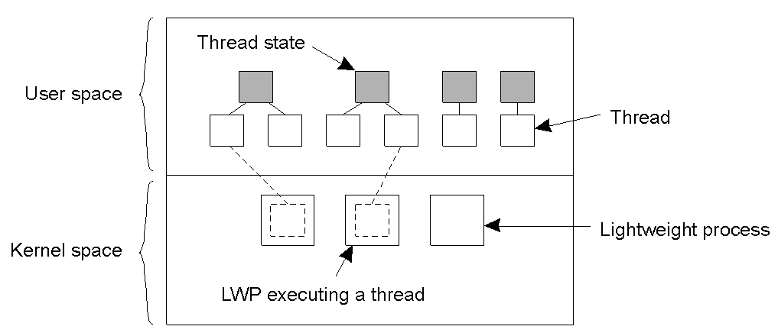
solution: use a hybrid form of user-level and kernel-level threads, called lightweight process (LWP)
a LWP runs in the context of a single (heavy-weight) process, and there can be several LWPs per process
the system also offers a user-level thread package for some operations such as creating and destroying threads, for thread synchronization (mutexes and condition variables)
the thread package can be shared by multiple LWPs
6
combining kernel-level lightweight processes and user-level threads

Slide 7
Threads in Distributed Systems
Multithreaded Clients
consider a Web browser; fetching different parts of a page can be implemented as a separate thread, each opening its own TCP/IP connection to the server or to separate and replicated servers
each can display the results as it gets its part of the page
Multithreaded Servers
servers can be constructed in three ways
a. Single-threaded process
it gets a request, examines it, carries it out to completion before getting the next request
the server is idle while waiting for disk read, i.e., system calls are blocking
7

Slide 8
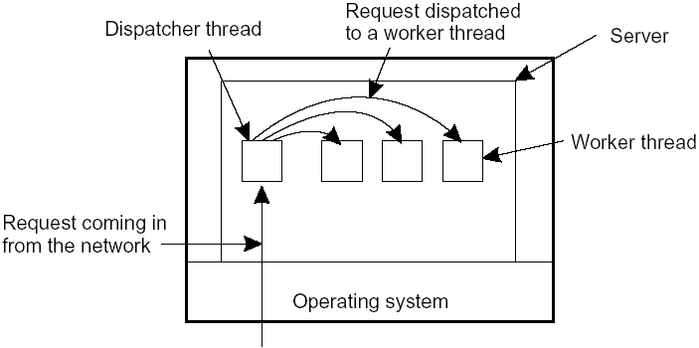
b. Threads
Threads are more important for implementing servers
e.g., a file server
The dispatcher thread reads incoming requests for a file operation from clients and passes it to an idle worker thread
The worker thread performs a blocking disk read; in which case another thread may continue, say the dispatcher or another worker thread
8
a multithreaded server organized in a dispatcher/worker model

Slide 9
c. Finite-state machine
if threads are not available
it gets a request, examines it, tries to fulfill the request from cache, else sends a request to the file system; but instead of blocking it records the state of the current request and proceeds to the next request
Summary
Model | Characteristics
Single-threaded process | No parallelism, blocking system calls
Threads | Parallelism, blocking system calls (thread only)
Finite-state machine | Parallelism, nonblocking system calls
three ways to construct a server
9

Slide 10
3.2 Anatomy of Clients
Two issues: user interfaces and client-side software for distribution transparency
a. User Interfaces
To create a convenient environment for the interaction of a human user and a remote server; e.g. mobile phones with simple displays and a set of keys
GUIs are most commonly used
The X Window System (or simply X)
it has the X kernel: the part of the OS that controls the terminal (monitor, keyboard, pointing device like a mouse) and is hardware dependent
contains all terminal-specific device drivers through the library called xlib
10

Slide 11
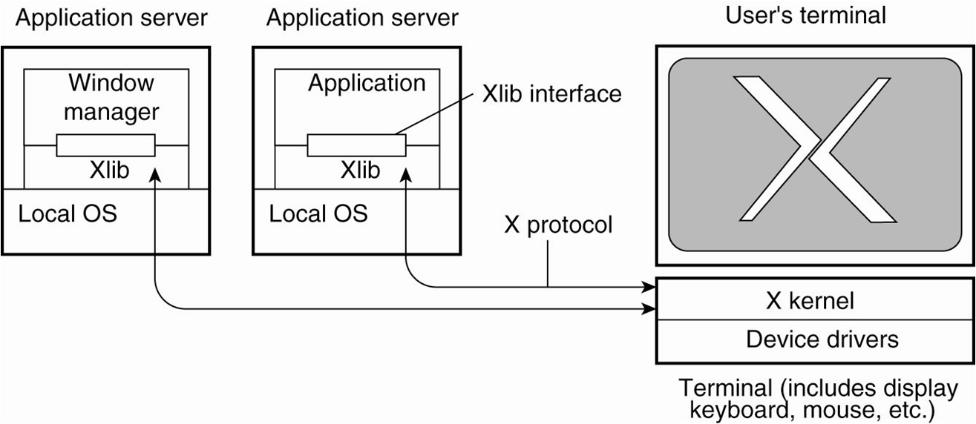
the basic organization of the X Window System
11

Slide 12
b. Client-Side Software for Distribution Transparency
In addition to the user interface, parts of the processing and data level in a client-server application are executed at the client side
An example is embedded client software for ATMs, cash registers, etc.
Moreover, client software can also include components to achieve distribution transparency
e.g., replication transparency
Assume a distributed system with replicated servers; the client proxy can send requests to each replica and a client side software can transparently collect all responses and passes a single return value to the client application
12

Slide 13
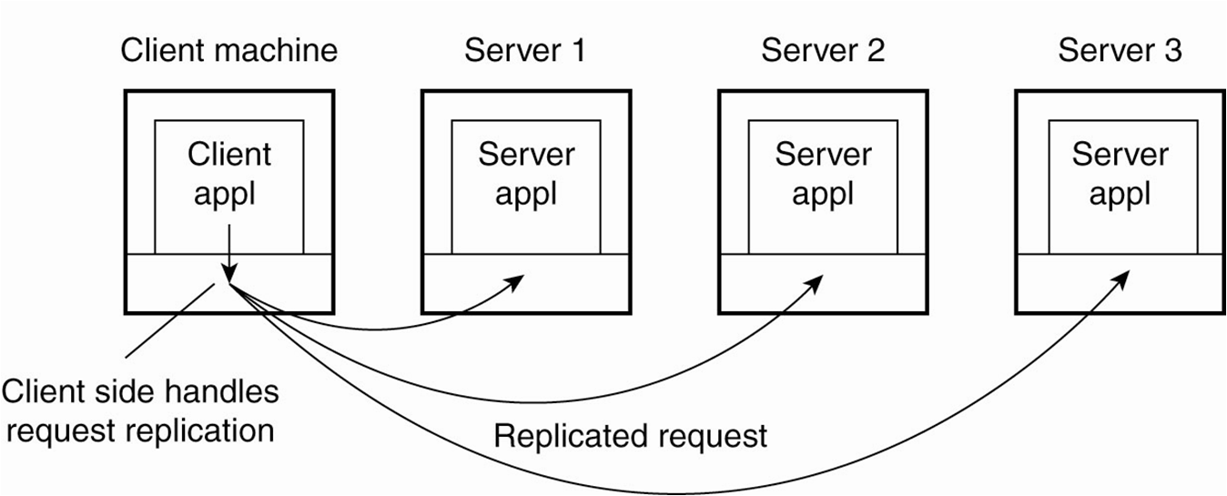
transparent replication of a server using a client-side solution
Access transparency and failure transparency can also be achieved using client-side software
13

Slide 14
3.3 Servers and design issues
3.3.1 General Design Issues
How to organize servers?
Where do clients contact a server?
Whether and how a server can be interrupted
Whether or not the server is stateless
a. How to organize servers?
Iterative server
the server itself handles the request and returns the result
Concurrent server
it passes a request to a separate process or thread and waits for the next incoming request; e.g., a multithreaded server; or by forking a new process as is done in Unix
14

Slide 15
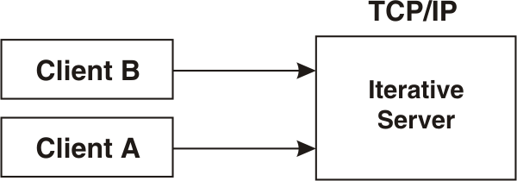
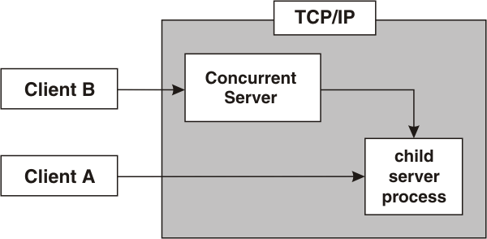
Handles single request at a time
Easy to build
Unnecessary delay
Iterative servers
Handles multiple requests at a time
Difficult to design and build
Better Performance
Concurrent Servers

Slide 16
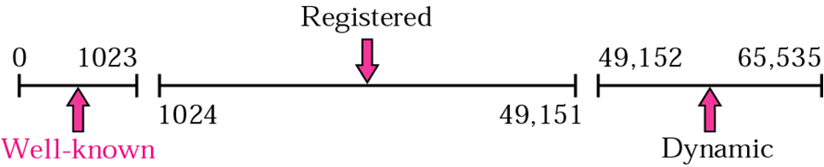
b. Where do clients contact a server?
using endpoints or ports at the machine where the server is running where each server listens to a specific endpoint
how do clients know the endpoint of a service?
Globally assign endpoints for well-known services; e.g. FTP is on TCP port 21, HTTP is on TCP port 80
For services that do not require preassigned endpoints, it can be dynamically assigned by the local OS
IANA (Internet Assigned Numbers Authority) Ranges
IANA divided the port numbers into three ranges
Well-known ports: assigned and controlled by IANA for standard services, e.g., DNS uses port 53
16

Slide 17
Registered ports: are not assigned and controlled by IANA; can only be registered with IANA to prevent duplication e.g., MySQL uses port 3306
Dynamic ports or ephemeral ports : neither controlled nor registered by IANA
How can the client know this endpoint? two approaches
i. have a daemon running and listening to a well-known endpoint; it keeps track of all endpoints of services on the collocated server
the client will first contact the daemon which provides it with the endpoint, and then the client contacts the specific server
17

Slide 19
c. Whether and how a server can be interrupted
for instance, a user may want to interrupt a file transfer, may be it was the wrong file
let the client exit the client application; this will break the connection to the server; the server will tear down the connection assuming that the client had crashed
or
let the client send out-of-bound data, data to be processed by the server before any other data from the client; the server may listen on a separate control endpoint; or send it on the same connection as urgent data as is in TCP
d. Whether or not the server is stateless
a stateless server does not keep information on the state of its clients; for instance a Web server
soft state: a server promises to maintain state for a limited time; e.g., to keep a client informed about updates; after the time expires, the client has to poll
19

Slide 20
a stateful server maintains information about its clients; for instance a file server that allows a client to keep a local copy of a file and can make update operations
3.3.2 Server Clusters
a server cluster is a collection of machines connected through a network (normally a LAN with high bandwidth and low latency) where each machine runs one or more servers
it is logically organized into three tiers
20

Slide 21
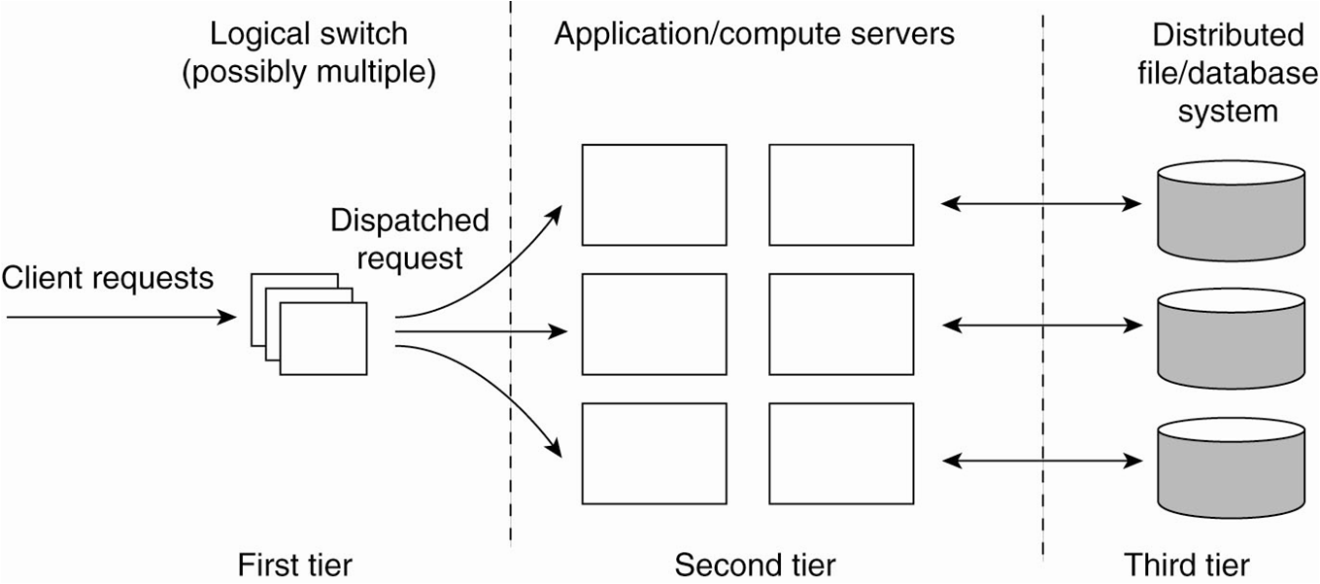
the general organization of a three-tiered server cluster
21

Slide 22
Distributed Servers
the problem with a server cluster is when the logical switch (single access point) fails making the cluster unavailable
hence, several access points can be provided where the addresses are publicly available leading to a distributed server
e.g., the DNS can return several addresses for the same host name
22

Slide 23
3.4 Code Migration
so far, communication was concerned on passing data
we may pass programs, even while running and in heterogeneous systems
Code migration also involves moving data as well: when a program migrates while running, its status, pending signals, and other environment variables such as the stack and the program counter also have to be moved
23

Slide 24
Reasons for Migrating Code
To improve performance; move processes from heavily-loaded to lightly-loaded machines (load balancing)
To reduce communication: move a client application that performs many database operations to a server if the database resides on the server; then send only results to the client
To exploit parallelism (for nonparallel programs): e.g., copies of a mobile program (a crawler as is called in search engines) moving from site to site searching the Web
24

Slide 25
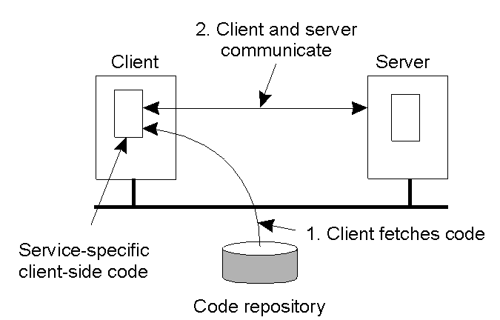
To have flexibility by dynamically configuring distributed systems: instead of having a multi-tiered client-server application deciding in advance which parts of a program are to be run where
the principle of dynamically configuring a client to communicate to a server; the client first fetches the necessary software, and then invokes the server
25

Slide 26
Models for Code Migration
a process consists of three segments: code segment (set of instructions), resource segment (references to external resources such as files, printers, ...), and execution segment (to store the current execution state of a process such as private data, the stack, the program counter)
Weak Mobility
transfer only the code segment and may be some initialization data; in this case a program always starts from its initial stage, e.g. Java Applets
execution can be by the target process (in its own address space like in Java Applets) or by a separate process
26

Slide 27
Strong Mobility
transfer code and execution segments; helps to migrate a process in execution
can also be supported by remote cloning; having an exact copy of the original process and running on a different machine; executed in parallel to the original process; UNIX does this by forking a child process
migration can be
sender-initiated: the machine where the code resides or is currently running; e.g., uploading programs to a server; may need authentication or that the client is a registered one
receiver-initiated: by the target machine; e.g., Java Applets; easier to implement
27

Slide 28
End of the Chapter

